Slide 1
Research Design
<number>/42

Slide 2
Decisions regarding what, where, when, how much
A research design
  the arrangement of conditions for collection and analysis of data in a manner that aims to combine relevance to the research purpose with economy in procedure.”
<number>/42

Slide 3
The designing decisions happen to be in respect of:
  (i) What is the study about?
  (ii) Why is the study being made?
  (iii) Where will the study be carried out?
  (iv) What type of data is required?
  (v) Where can the required data be found?
  (vi) What periods of time will the study include?
  (vii) What will be the sample design?
  (viii) What techniques of data collection will be used?
  (ix) How will the data be analyzed?
  (x) In what style will the report be prepared?
<number>/42

Slide 4
Split the overall research design into the following parts:
  (a) sampling design
    the method of selecting items to be observed;
  (b) observational design
    the conditions under which the observations are to be made;
  (c) statistical design
    the question of how many items are to be observed and how the information and data gathered are to be analysed;
  (d) operational design
    the techniques by which the procedures specified in the sampling, statistical and observational designs can be carried out.
<number>/42

Slide 5
The important features of a research design
  (i) a plan
    specifies the sources & types of information relevant to the research problem
  (ii) a strategy
    which approach will be used for gathering and analyzing the data.
  (iii) the time and cost budgets
    most studies are done under these two constraints
<number>/42

Slide 6
Research design must, at least, contain—
  (a) a clear statement of the research problem;
  (b) procedures and techniques to be used for gathering information;
  (c) the population to be studied;
  (d) methods to be used in processing and analyzing data
<number>/42

Slide 7
The various concepts relating to designs
1. Dependent and independent variables
  A concept which can take on different quantitative values (a variable)
  Qualitative phenomena (or the attributes) are also quantified
  If one variable depends upon or is a consequence of the other variable --- a dependent variable,
  the variable that is antecedent to the dependent variable --- an independent variable.
<number>/42

Slide 8
2. Extraneous variable:
  Independent variables that are not related to the purpose of the study, but may affect the dependent variable
    the researcher wants to test the hypothesis: a relationship between children’s gains in social studies achievement and their self-concepts
      self-concept is an independent variable, social studies achievement is a dependent variable.
      Intelligence may as well affect the social studies achievement, but since it is not related to the purpose of the study undertaken by the researcher, it will be termed as an extraneous variable.
  Whatever effect is noticed on dependent variable as a result of extraneous variable(s) is technically described as an ‘experimental error’.
<number>/42

Slide 9
Control: One important characteristic of a good research design is to minimise the influence or effect of extraneous variable(s).
The technical term ‘control’ is used when we design the study minimising the effects of extraneous independent variables.
In experimental researches, the term ‘control’ is used to refer to restrain experimental conditions
<number>/42

Slide 10
Research hypothesis: When a prediction or a hypothesised relationship is to be tested by scientific
methods, it is termed as research hypothesis.
The research hypothesis is a predictive statement that relates an independent variable to a dependent variable
<number>/42

Slide 11
Experimental and non-experimental hypothesis-testing research: When the purpose of research is to test a research hypothesis, it is termed as hypothesis-testing research.
It can be of the experimental design or of the non-experimental design.
Research in which the independent variable is manipulated is termed ‘experimental hypothesis-testing research’ and a research in which an independent variable is not manipulated is called ‘non-experimental hypothesis-testing research’.
<number>/42

Slide 12
Experimental and control groups: In an experimental hypothesis-testing research when a group is exposed to usual conditions, it is termed a ‘control group’, but when the group is exposed to
some novel or special condition, it is termed an ‘experimental group’.
<number>/42

Slide 13
Experiment: The process of examining the truth of a statistical hypothesis, relating to some research problem, is known as an experiment.
For example, we can conduct an experiment to examine the usefulness of a certain newly developed drug.
Experiments can be of two types viz., absolute experiment and comparative experiment.
If we want to determine the impact of a fertilizer on the yield of a crop, it is a case of absolute experiment;
but if we want to determine the impact of one fertilizer as compared to the impact of some other fertilizer, our experiment then will be termed as a comparative experiment
<number>/42

Slide 14
NEED FOR RESEARCH DESIGN
Research design is needed because it facilitates the smooth sailing of the various research operations.
Thereby making research as efficient as possible yielding maximal information with minimal expenditure of effort, time and money.
Just as for better, economical and attractive construction of a house,
we need a blueprint (or what is commonly called the map of the house) well thought out and prepared by an expert architect, similarly we need a research design or a plan in advance of data collection and analysis for our research project.
<number>/42

Slide 15
Research design stands for advance planning of the methods to be adopted for collecting the relevant data and the techniques to be used in their analysis, keeping in view the objective of the research and the availability of staff, time and money.
Preparation of the research design should be done with great care as any error in it may upset the entire project.
Research design, in fact, has a great bearing on the reliability of the results arrived at and as such constitutes the firm foundation of the entire edifice of the research work.
<number>/42

Slide 16
FEATURES OF A GOOD DESIGN
A good design is often characterised by adjectives like flexible, appropriate, efficient, economical and so on.
Generally, the design which minimises bias and maximises the reliability of the data collected and analysed is considered a good design.
The design which gives the smallest experimental error is supposed to be the best design in many investigations.
Similarly, a design which yields maximal information and provides an opportunity for considering many different aspects of a problem is considered most appropriate and efficient design in respect of many research problems.
<number>/42

Slide 17
A research design appropriate for a particular research problem, usually involves the consideration of the following factors:
(i) the means of obtaining information;
(ii) the availability and skills of the researcher and his staff, if any;
(iii) the objective of the problem to be studied;
(iv) the nature of the problem to be studied; and
(v) the availability of time and money for the research work.
<number>/42

Slide 18
DIFFERENT RESEARCH DESIGNS
1. Exploratory research studies
  also termed as formulative research studies
  The main purpose
    formulating a problem for more precise investigation
    of developing the working hypotheses from an operational point of view
    The major emphasis is on the discovery of ideas and insights
<number>/42

Slide 19
Generally, three methods in the context of research design for such studies
  (a) the survey of concerning literature;
  (b) the experience survey; and
  (c) the analysis of ‘insight-stimulating’ examples.
<number>/42

Slide 20
The survey of concerning literature
  to be the most simple and fruitful method of formulating precisely the research problem or developing hypothesis.
    Hypotheses stated by earlier workers may be reviewed and their usefulness be evaluated as a basis for further research.
    It may also be considered whether the already stated hypotheses suggest new hypothesis.
<number>/42

Slide 21
Experience survey
  To obtain insight into the relationships between variables and new ideas relating to the research problem
2. Descriptive and diagnostic research studies
  Descriptive research studies
    describing the characteristics of a particular individual, or of a group
  Diagnostic research studies
    determine the frequency with which something occurs
    or its association with something else
<number>/42

Slide 22
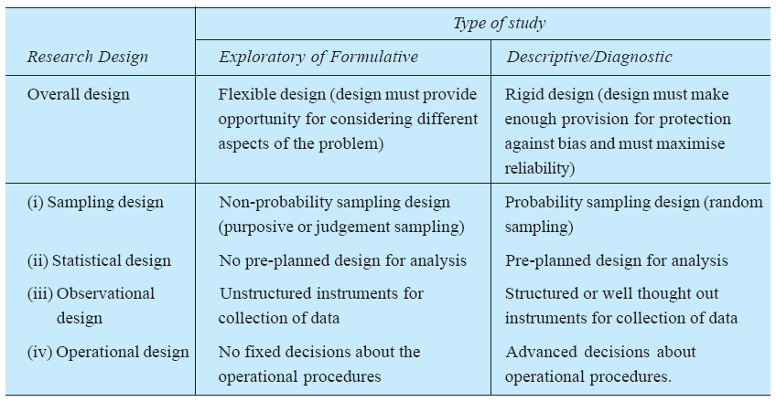
<number>/42

Slide 23
3. hypothesis-testing research studies
  known as experimental studies or design of experiments
    tests the hypotheses of causal relationships between variables
  Usually experiments meet this requirement
  Three basic principles of experimental designs
    (1) the Principle of Replication;
    (2) the Principle of Randomization;
    (3) Principle of Local Control.
<number>/42

Slide 24
The Principle of Replication
  the experiment should be repeated more than once
  The statistical accuracy of the experiments is increased
    For example, if an experiment requiring a two-way analysis of variance is replicated, it will then require a three-way analysis of variance since replication itself may be a source of variation in the data
<number>/42

Slide 25
The Principle of Randomization
  Design or plan the experiment that the variations caused by extraneous factors
    For instance, if we grow one variety of rice, say, in the first half of the parts of a field and the other variety is grown in the other half, then it is just possible that the soil fertility may be different in the first half in comparison to the other half. If this is so, our results would not be realistic.
    In such a situation, we may assign the variety of rice to be grown in different parts of the field on the basis of some random sampling technique i.e., we may apply randomization principle and protect ourselves against the effects of the extraneous factors.
  The principle of randomization, have a better estimate of the experimental error.
<number>/42

Slide 26
The Principle of Local Control
  Plan the experiment for performing a two-way analysis of variance
  In other words,
    first divide the field into several homogeneous parts, known as blocks,
    then each such block is divided into parts equal to the number of treatments.
    Then the treatments are randomly assigned to these parts of a block.
the principle of local control can eliminate the variability due to extraneous factor(s) from the experimental error
<number>/42

Slide 27
Basic Principle of Experiment
Do Yourself
<number>/42

